Slide 1
MRA- MILESTONE 2
RITUSRI MOHAN

Slide 2
CONTENTS
PROBLEM STATEMENT
TOOLS USED FOR ANALYSIS
EXECUTIVE SUMMARY OF DATA
EXPLORATORY DATA ANALYSIS
MARKET BASKET ANALYSIS
MARKET BASKET ANALYSIS- ASSOCIATION RULES
MARKET BASKET ANALYSIS- KNIME WORKFLOW
MARKET BASKET ANALYSIS- RESULTS
INSIGHTS & RECOMMENDATIONS

Slide 3
PROBLEM STATEMENT
A Grocery Store shared the transactional data with you. Your job is to identify the most popular combos that can be suggested to the Grocery Store chain after a thorough analysis of the most commonly occurring sets of menu items in the customer orders. The Store doesn’t have any combo meals. Can you suggest the best combo meals?

Slide 4
TOOLS USED FOR ANALYSIS
TABLEAU:
The Exploratory Data Analysis was done using Tableau.
Copy + Paste the Link :
https://public.tableau.com/app/profile/ritusri.mohan/viz/RitusriMohan-MRAMilestone2/Productsorderedbyyear?publish=yes
KNIME:
The KNIME Workflow file is also attached.

Slide 5
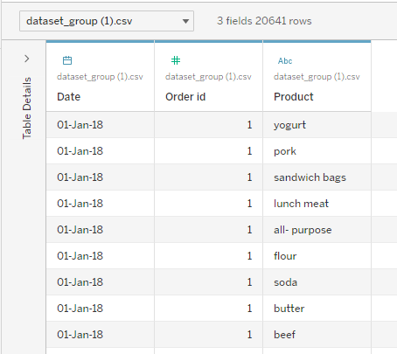
EXECUTIVE SUMMARY OF DATA
There are 20641 rows and 3 columns in the given dataset.
There are no missing values and no duplicates.
There is 1 numeric variable, 1 datetime variable and 1 categorical variable.
Data is provided from January to September for 2018 and 2019, and for 2020, January and February.

Slide 6
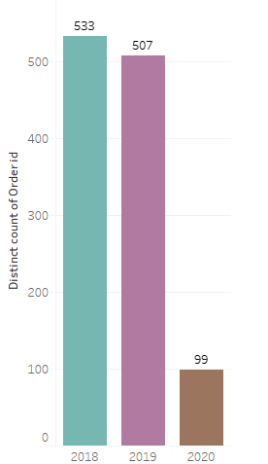

EXPLORATORY DATA ANALYSIS
YEARLY SALES
2018 has the highest number of sales and 2020 has least number of sales.

Slide 7
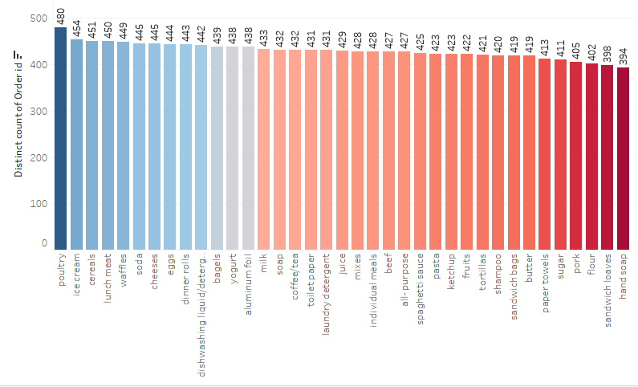
EXPLORATORY DATA ANALYSIS
PRODUCTS ORDERED
The top 5 products ordered over the years are :
Poultry
Ice cream
Cereals
Lunch meat
waffles

Slide 8
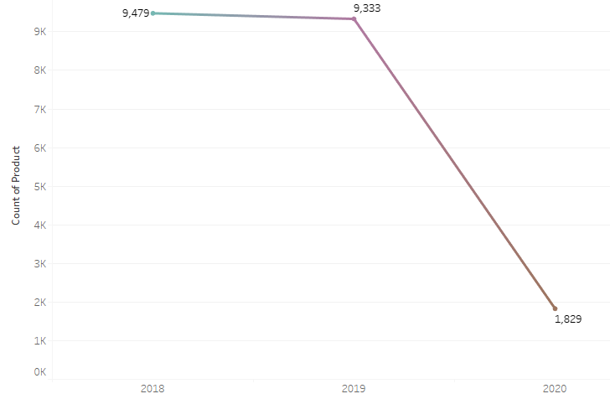
EXPLORATORY DATA ANALYSIS
YEARLY ORDERS TREND
The highest number of sales are in 2018 followed by a decrease in 2019 and then in 2020.
For 2020, it cannot be said that sales are less as the data given is only for first two months of the year.

Slide 9
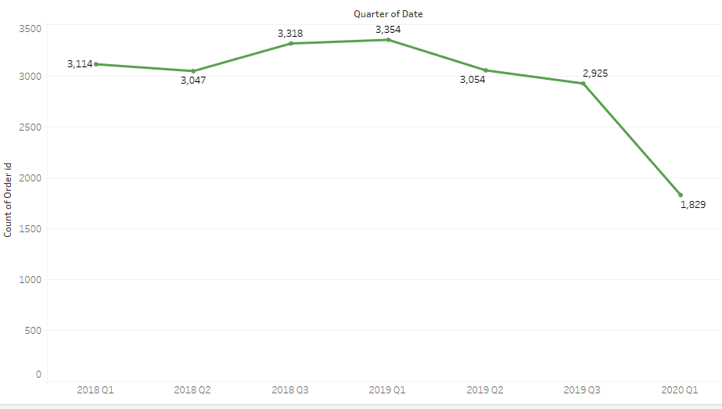
EXPLORATORY DATA ANALYSIS
QUARTERLY ORDERS TREND
Highest number of orders can be seen from Q1 of 2019 , followed by Q3 and then Q2 of 2018.
It can be said that the period of growth of sales was from around June 2018 to September 2019.

Slide 10
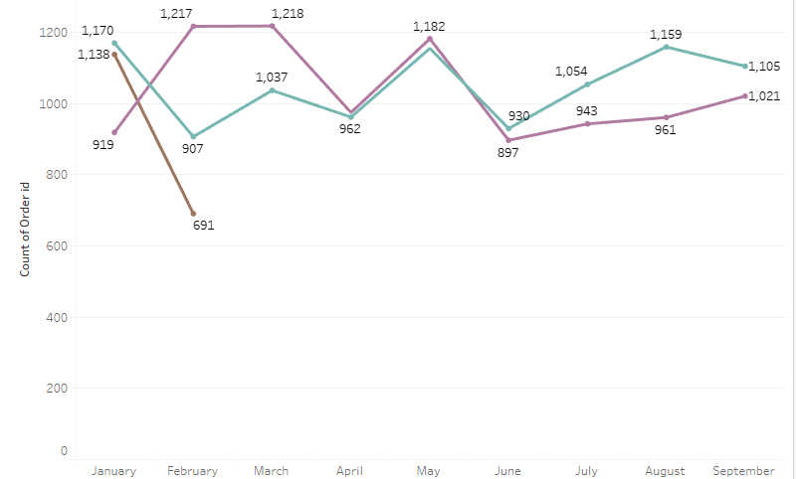
EXPLORATORY DATA ANALYSIS
MONTHLY ORDERS TREND
Orders on a monthly basis for every year can be seen. There is no trend or seasonality being followed.

Slide 11
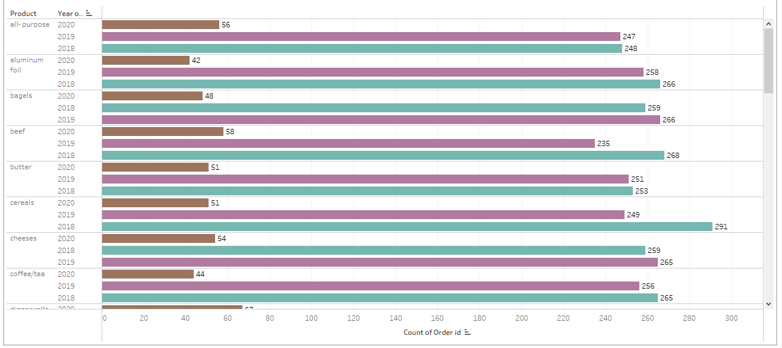
EXPLORATORY DATA ANALYSIS
QUANTITY OF PRODUCTS ORDERED OVER THE YEARS

Slide 12
MARKET BASKET ANALYSIS
Market basket analysis is a technique used by retailers to increase sales by better understanding customer purchasing patterns. It involves analyzing large data sets, such as purchase history, to reveal product groupings, as well as product.
IfThen scenario rules are developed using market basket analysis, for instance, item B is likely to be purchased if item A is purchased. In other words, they are formed from the rates of co-occurrence in the observations.
The technique determines relationships of what products were purchased with which other product(s). These relationships are then used to build profiles containing If-Then rules of the items purchased.
The If Then rules could be written as- If {A} Then {B}
The If part of the rule (the {A} above) is known as the antecedent (condition)and the THEN part (the {B} above) of the rule is known as the consequent (result) .

Slide 13
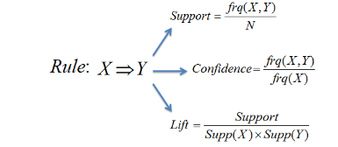
MARKET BASKET ANALYSIS- ASSOCIATION RULES
The Association rule has three measures that express the degree of confidence in the rule, Support, Confidence, and Lift.
Support: Its the default popularity of an item. In mathematical terms, the support of item A is nothing but the ratio of transactions involving A to the total number of transactions.
Confidence: Likelihood that customer who bought both A and B. Its divides the number of transactions involving both A and B by the number of transactions involving B.
Lift : Increase in the sale of A when you sell B.

Slide 14
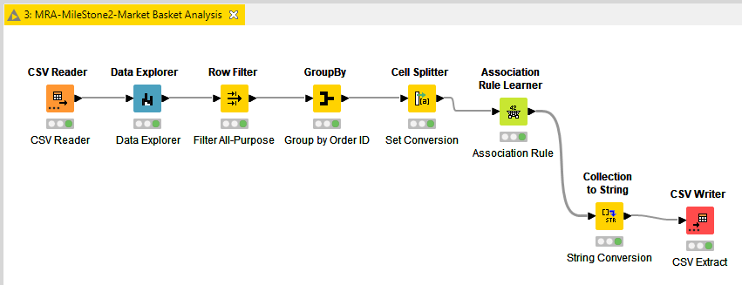
MARKET BASKET ANALYSIS- KNIME WORKFLOW

Slide 15
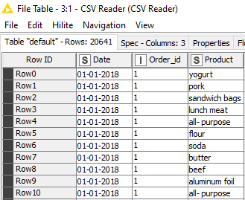
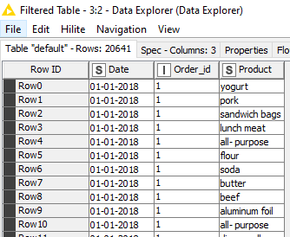
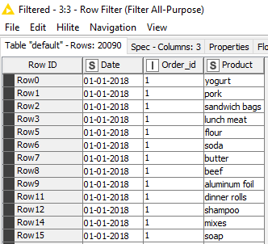
MARKET BASKET ANALYSIS - RESULTS
1. CSV READER
2. DATA EXPLORER
3. ROW FILTER

Slide 16
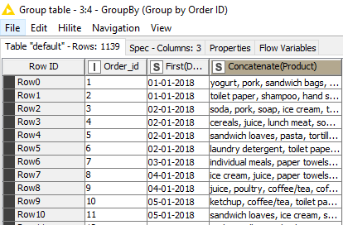
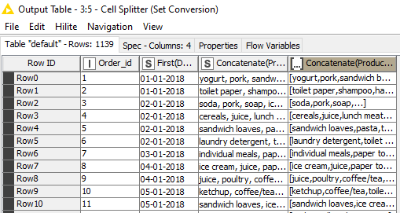
MARKET BASKET ANALYSIS- RESULTS
4. GROUPBY
5. CELL SPLITTER

Slide 17
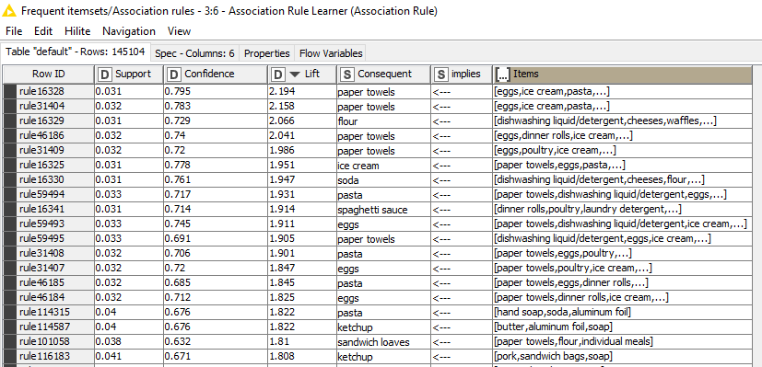
MARKET BASKET ANALYSIS -RESULTS
6. ASSOCIATION RULE LEARNER
For our Market Basket Analysis, this is the most crucial node.
We added a value to our Support metric, which ranges from 0 to 1, and now we have the three metrics Support, Confidence, and Lift.
We added a value of 0.03, or 3% of the total sales of a product, and we used the association rule's 0.05 minimum confidence level.

Slide 18
INSIGHTS & RECOMMENDATION
To promote the sale of the preferred combinations, we can place an easy lift-up counter of the top combinations next to the sales counter or billing counter.
Given that sandwiches and soda are the least popular commodities and poultry and soap are the most popular, a combined offer of these would gradually boost sales of sandwiches and soap as well.
In order to promote the sale of the least popular products and the frequency of consumers, we can give unique discount coupons on the least popular products purchased and on the subsequent shopping for all products.
Some top combos with high lift and confidence levels are :

Slide 19
THANK YOU

